Slide 1
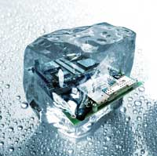
Design pattern Introduction
Hoa Vo
Quan Tran
2015.09.26

Slide 2
Problems
Problems when developing software
Readable
Maintainable
Scalable
Testable
…

Slide 3
OOP concepts
OOP concepts: Abstract class, interface, inheritance, polymorphism … use for ??

Slide 4
Content
What is this

Slide 5
What
Solutions to common problems
Make the code
Reusable
Maintainable
Scalable
Testable

Slide 6
It base on OOP concept
It capture from SE experiences

Slide 7
Type
Creational
Behavioral
Structural

Slide 8
Creational
Abstract Factory
Factory Method
Prototype
Builder
Singleton

Slide 9
Structural
Adapter
Composite
Bridge
Decorator
Facade
Flyweight
Proxy

Slide 10
Behavioral
Chain of Resp.
Command
Interpreter
Iterator
Mediator
Memento
Observer
State
Strategy
Template Method
Visitor

Slide 11
Still don’t understand
Let DoJo

Slide 12

Question & Answer
Any questions ?

Slide 13




Thank for your attention
www.sioux.asia
+84 (0) 5113888756
contact@sioux.asia

